Slide 1
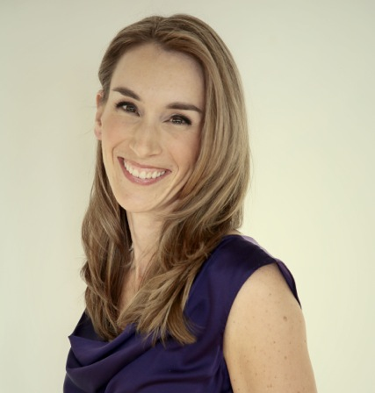
info@seejakeandjanetrain.com
REVENUE, RETENTION and REFERALS
This is the intellectual property of See Jake and Jane Train. Please use for you professional development and as a compliment to attending the 2018 NSCA GL Regional Conference. If you would like to share or repurpose any of these materials please just drop us a line! We would be happy to facilitate.
Email: info@seejakeandjanetrain.com
Many thanks for your attendance and commitment to elevating this industry! You are the future and the powerful catalysts in our communities’ efforts to live healthfully and exponentially improve their lives. Thank you!
I am honored to help. Reach out anytime! -Michelle
Notes:
Michelle Blakely
michelle@seejakeandjanetrain.com
Mobile: 773.680.6824

Slide 2
info@seejakeandjanetrain.com
REVENUE, RETENTION
and REFERALS
Michelle Blakely
Founder
See Jake and Jane Train

Slide 3
info@seejakeandjanetrain.com
Thank you!
Chris Powell, Renee Hoppe
NSCA
SJJT Clients
and You!

Slide 4
info@seejakeandjanetrain.com
KISS
HERE TO HELP!
Streamline Efforts
Accountant’s Daughter
Accelerator Experience
18-40% revenue increases
ROI of 35 days
4 BUFFETS OF INFORMATION:
WS MOMENTS
Notes:
Here to help
Personal Trainers in out Nine Week Turnaround Course Earn 18-40% more after the course. Their return on investment is 35 days.

Slide 5
info@seejakeandjanetrain.com
TODAY
Revenue
Retention
Referrals
Branding And Social Media

Slide 6
info@seejakeandjanetrain.com
“Money doesn’t make you happy but it does make you comfortable. It allows you to extend the good you do beyond your physical presence.”
-quote of the day podcast
INFLUENCES
Notes:
WHAT IS INFLUENCING YOU IN YOUR LIFE REGARDING MONEY? HAVE YOU FOUND GREAT RESOURCES THAT CAN POSITIVELY INFLUENCE YOU? AND INFLUENCE YOU IN A WAY THAT SPEAKS TO YOUR BELIEF SYSTEM?

Slide 7
info@seejakeandjanetrain.com
INFLUENCES
Close your eyes
WS Moment
abundance v scarcity
Notes:
Scarcity or Abundance
WHAT IS INFLUENCING YOU IN YOUR LIFE REGARDING MONEY? HAVE YOU FOUND GREAT RESOURCES THAT CAN POSITIVELY INFLUENCE YOU? AND INFLUENCE YOU IN A WAY THAT SPEAKS TO YOUR BELIEF SYSTEM? ONE SIDE LIST MESSAGES OF ABUNDANCE. OTHER… MESSAGES OF SCARCITY. BE AWARE OF OUR INFLUENCES AND MESSAGES.

Slide 8
info@seejakeandjanetrain.com
REVENUE:
Truly Know Your Numbers
Enlist help
Your head and sand
Notes:
only one take away – Know Your Numbers – Keep things as simple as possible and then work through the details
as you go month to month. Digital banking? File Cabinet? Excel spreadsheet? Pencil and paper? Whatever works for you is the right system.
Get help where you need it.
Don’t ignore problems. Address them one small bite at time.

Slide 9
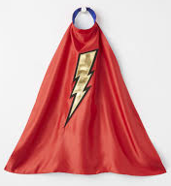
info@seejakeandjanetrain.com
REVENUE:
EXAMPLE: Tie expenses to revenue SJJT Client
EXAMPLE: Incentivize $250 SJJT Client
Notes:
HEROIC story…. Paying salary to trainer, paying stipend to keep trainer, no real incentives for the trainer to perform better
COMFY story… win win win incentivizing $250 for each trainer if studio acquires 10 new clients in a month
TIE INCENTIVES TO REVENUE

Slide 10
info@seejakeandjanetrain.com
REVENUE:
Communicate Numbers to your team
Listen to your trainers’
financial/career goals!
Think outside the box.
Notes:
Do not fear trainers that want to earn a lot… EMPOWER them!

Slide 11
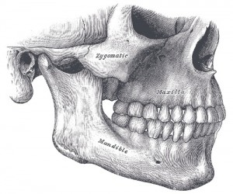
info@seejakeandjanetrain.com
REVENUE:
Niche
http://progressivedental-ellenlimdds.com/wp-content/uploads/2016/02/jaw-bone.jpg
https://en.wikipedia.org/wiki/Chanel
https://www.bleedingcool.com/2017/06/05/unreal-season-3-delayed-2018-greg-berlanti/
Notes:
Niche: what are you good at… specialize – don’t fear it – don’t try to be something you are not, close your eyes think of phony people in your life, think of authentic, real people, more relatable
Physical therapist that only does cranial / jaw work. Stop trying to be everything to every one, Channel counter –honest with me as the expert, me as the shopper.
Develop systems that speak to that honesty and specialty.

Slide 12
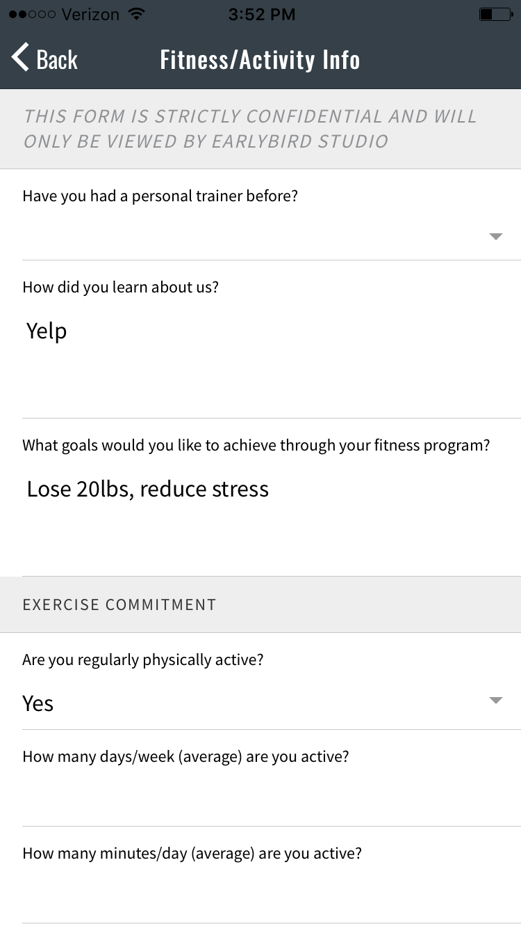
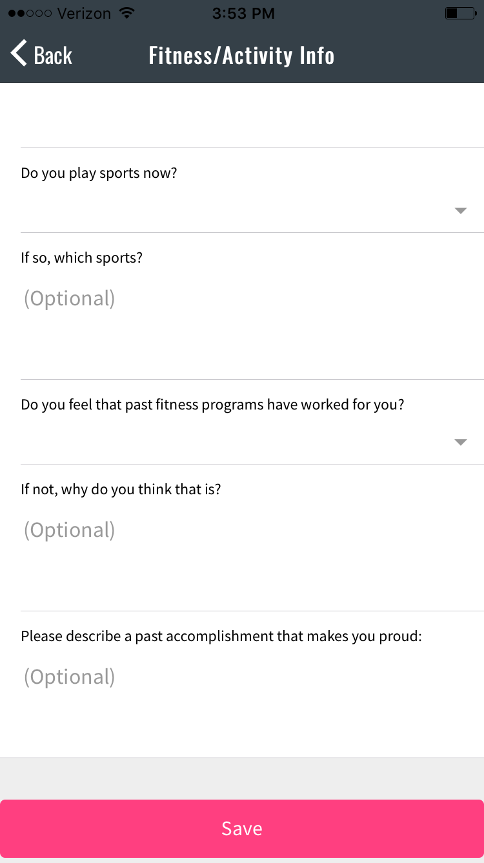
info@seejakeandjanetrain.com
REVENUE:
seriously
INTAKE
Notes:
INTAKE – take yourself seriously and clients will take your services seriously, know what you need legally, know what you need to provide/deliver the best service and then insist on that… (Pic of intake form in our see jake and jane train app)

Slide 13
info@seejakeandjanetrain.com
REVENUE:
INTAKE
=
IMPRESSION
Notes:
INTAKE – sets the tone creates a brilliant first impression… client… dating analogy… “start things how you want to finish them”

Slide 14
info@seejakeandjanetrain.com
REVENUE:
High End Service / Industry
Enormous Problem Solvers (healthy living)
Trainers MUST understand their worth
100 benefits of Exercise in NWT
Notes:
MUST MUST MUST – we are delivering a one on one or semi or small group training experience that has a cost, expertise solving an enormous problem for our country, our citizens and our communities (throw out some stats), we cannot undervalue that, must get our trainers/staff to understand their worth, 100 benefits of exercise list in our Nine Week Turnaround course

Slide 15
info@seejakeandjanetrain.com
REVENUE:
YOU ARE NOT YOUR customer
“bus stop occupation” (higher than Rest. Ind.)
raise the bar of professionalism
Notes:
YOU ARE NOT YOUR customer – own that and stop presenting only the types of offerings that you would buy, appreciate, need or want, and not offerring the items/details they do want. Step into their shoes.
In our industry… too little great practitioners, too few great trainers, our turnover rate is higher than the restaurant industry!, colleague: “bus stop occupation”, raise the bar of professionalism

Slide 16
info@seejakeandjanetrain.com
REVENUE:
Goals: We are a goal-oriented field? How many of us start the intake process with learning what our potential clients goals are? Why?
Well…
Where are your revenue goals written?
Notes:
Goals: We are a goal-oriented field? How many of us start the intake process with learning what our potential clients goals are? Why? Well… What are your financial goals for your company? Think outside the box. Did you write them down??? Does your staff know? Is your staff part of it? Is it posted somewhere? Did they post their goals? Do you know what they want/need to earn? Do you know what financially motivates them? Health insurance? Clothing expense? CEU benefit? Group retreat? Understand that this is a win=win=win. I LOVE hearing when trainers want to hit the $100K mark (or relative depending on your location), even employee trainers ($65 x 30 x 50)

Slide 17
info@seejakeandjanetrain.com
REVENUE:
WS MOMENT
We’re going to write them down
Personal and Professional
Notes:
WORKSHOP MOMENT: really think about your goals financially… write them down
Biz and Personal Separate –
what do you need –
what do you want –
where are you at –
what is the WIN-WIN-WIN to get there – don’t worry about everyone else – worry about you

Slide 18
info@seejakeandjanetrain.com
REVENUE:
Efficiency in offerings:
small group training
half hour sessions
recurring monthly billing
you must be at the top of your game
you must be a team of consummate professionals
BRAND your offerings…

Slide 19
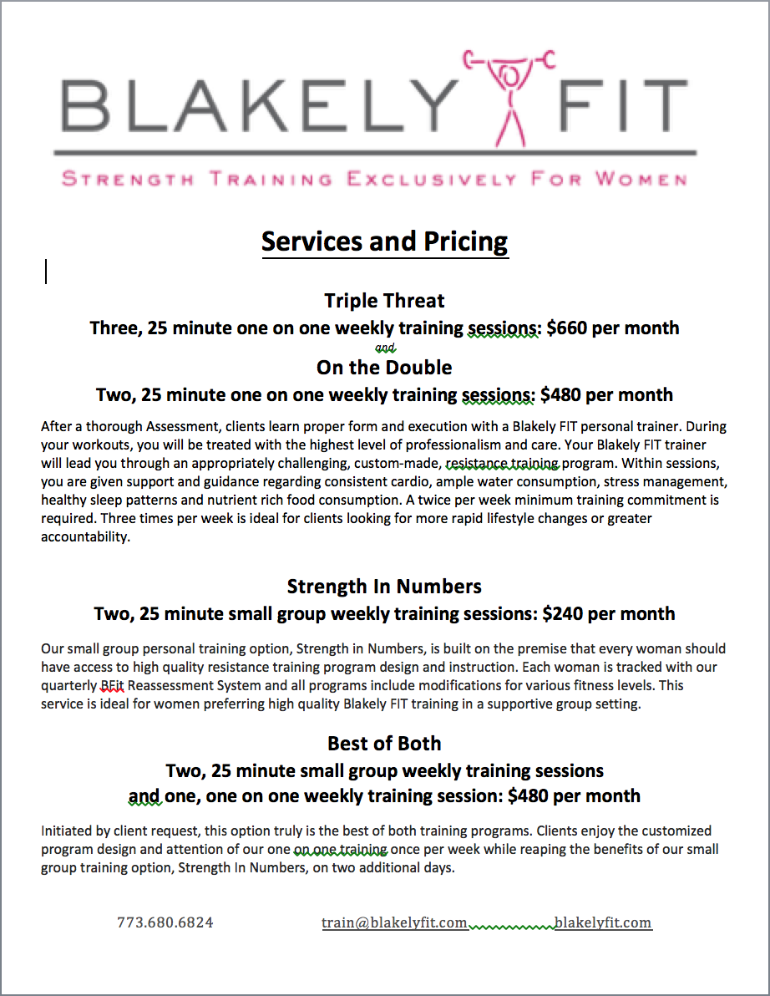
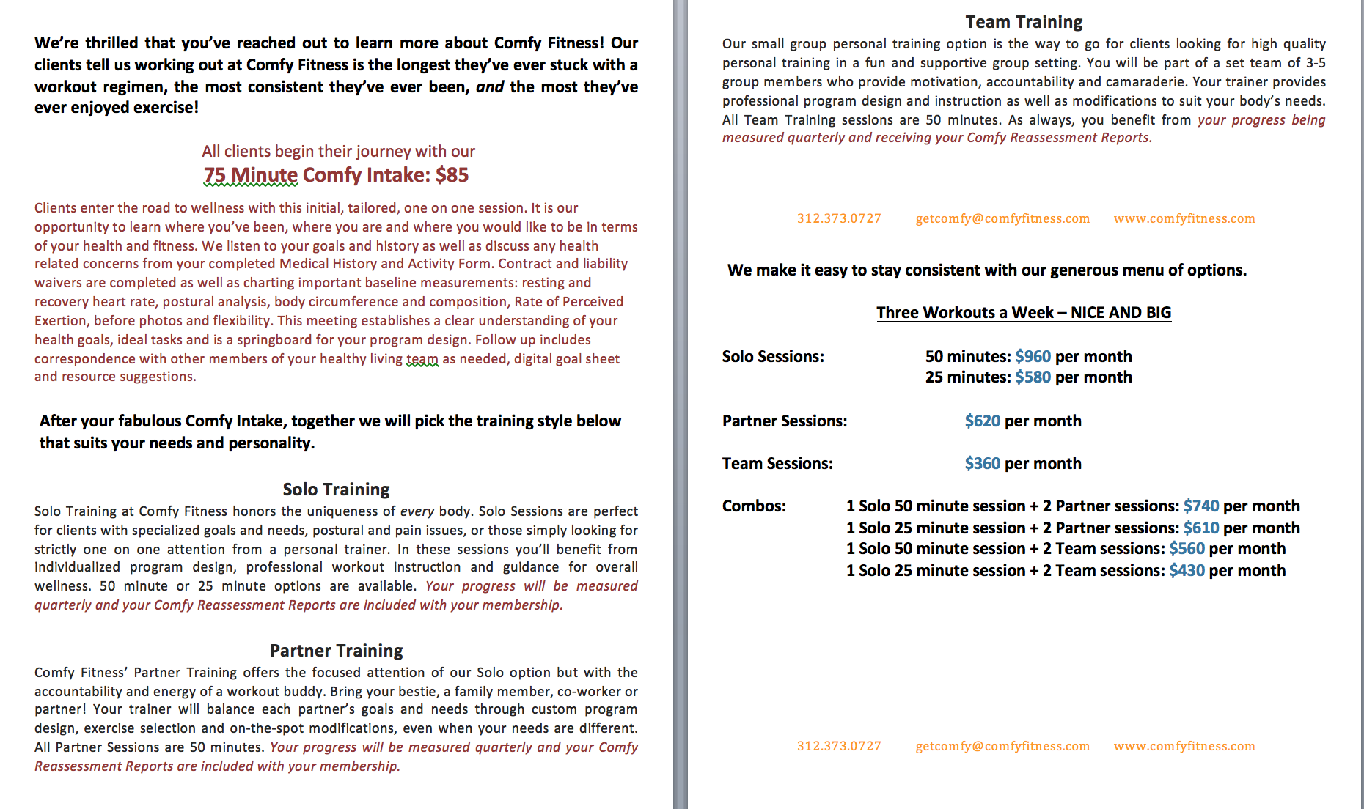
info@seejakeandjanetrain.com
REVENUE:
BRAND OFFERINGS… (naming and tone)
Notes:
Brand your offerings

Slide 20
info@seejakeandjanetrain.com
REVENUE:
BRAND OFFERINGS
Make it easy to buy
Notes:
Make it easy to buy… stand in your cliens shoes and make sure it’s EASY to buy and understand

Slide 21
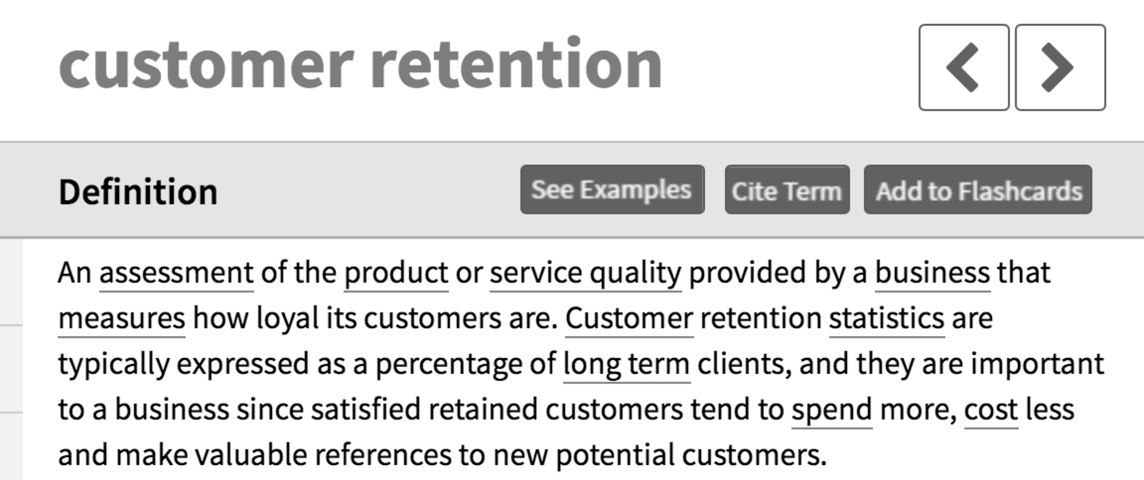
info@seejakeandjanetrain.com
REVENUE, RETENTION AND REFERRALS
http://www.businessdictionary.com/definition/customer-retention.html

Slide 22
info@seejakeandjanetrain.com
RETENTION:
What are you doing to communicate the benefits of your work with clients on a recurring basis? SHOUT IT OUT
Notes:
What are you doing to communicate the benefits of your work with clients on a recurring basis? SJJT app – reassessment… easy, powerful, differentiator from group x, differentiator from MANY personal training experiences, (huge branding experience)
5 Questions download on our website… for free for you

Slide 23
info@seejakeandjanetrain.com
RETENTION:
Free tool: 5 Questions
www.seejakeandjanetrain.com
Free tool: Last question of the session
Notes:
What are you doing to communicate the benefits of your work with clients on a recurring basis? SJJT app – reassessment… easy, powerful, differentiator from group x, differentiator from MANY personal training experiences, (huge branding experience)
5 Questions

Slide 24
info@seejakeandjanetrain.com
RETENTION:
Know the research… healthier people…
make more money,
improves self-esteem and confidence ,
reduce anxiety,
sleep better,
can give more to those they love,
effective personal training empowers ALL of that in their lives
Miriam E. Nelson and on and on and on…
COMMUNICATE THIS TO CLIENTS

Slide 25
info@seejakeandjanetrain.com
RETENTION:
What are you doing to say thank you?
JUST BECAUSE
Notes:
Keep a personal relationship healthy… do the same with business

Slide 26
info@seejakeandjanetrain.com
RETENTION:
Elevate our service before the client requests it,
be proactive in educating clients about other trends in food, wellness, strength training, clothing, software, devices,
BE THEIR TRUSTED EXPERT RESOURCE, incentivize in silly ways…
Notes:
Elevate our service before the client requests it, be proactive in educating clients about other trends in food, wellness, strength training, clothing, software, devices, BE THERE TRUSTED EXPERT RESOURCE, incentivize in silly ways… every client showed up to Small Group Training: gift.

Slide 27
info@seejakeandjanetrain.com
RETENTION:
Find room for clients as their lives/needs change…
they need more of you… not less…
BRANDING opportunity… small group, couples training, one on one, frequency, complimentary services all allow you to stay with in your niche while delivering what they need…

Slide 28
info@seejakeandjanetrain.com
RETENTION: SIDE NOTE!!!!
Studio owners / managers… what are you doing to communicate the evolution of offerings to your trainers on the floor with clients

Slide 29
info@seejakeandjanetrain.com
RETENTION:
Be consistent in your attendance
Be consistent in your conversations
Be consistent in your follow through
Be consistent in your start and end times
Years of asking… shocking answers

Slide 30
info@seejakeandjanetrain.com
RETENTION:
WORKSHOP MOMENT:
Share Shopping Experience
Does everyone see and feel the big picture on your team?
Notes:
Email if you would like this. michelle@seejakeandjanetrain.com

Slide 31
info@seejakeandjanetrain.com
REVENUE, RETENTION AND REFERRALS
http://www.dictionary.com/browse/referral

Slide 32
info@seejakeandjanetrain.com
REFERRALS:
Ideal leads not just any leads
Postcard story (Dan)
Print Ad story (Carsten)
Notes:
Only invest in what works

Slide 33
info@seejakeandjanetrain.com
REFERRALS:
WORKSHOP MOMENT:
Testimonials and Referrals course excerpt (TAR)
Notes:
Print for everyone to work through… mention that it is part of the course,
Leads discussion
Email for copy: michelle@seejakeandjanetrain.com

Slide 34
info@seejakeandjanetrain.com
REFERRALS: Leads Next Step
Greet with name and handshake (practice)
Thank them for interest
Express enthusiasm and professionalism
LISTEN
Clearly take and move the ball forward with explicit options / directions / expectations
Confirm next steps

Slide 35
info@seejakeandjanetrain.com
REFERRALS:
Leads Next Step
Hi Jen!
Thank you for your recent inquiry about our facility.
We are very excited that you're interested in visiting our studio! Our staff can't wait to help you achieve and exceed all of your personal fitness goals!
Give us a call to schedule your free day pass. In addition, if you call today we'll include a free personal consultation which involves taking your body composition measurements, discussing your fitness goals, and helping to outline your path to success!
The secret to moving forward is getting started, so don't wait to schedule your first training session, call us today.
Please reach out to either Brad at 847-217-5979 or Jose at 847-917-4849 to schedule your appointment.
We look forward to hearing from you!
Sincerely, Margaret

Slide 36
info@seejakeandjanetrain.com
REFERRALS:
Leads Next Step
Hi Jen!
Thank you for your recent inquiry about our facility.
We are very excited that you're interested in visiting our studio! Our staff can't wait to help you achieve and exceed all of your personal fitness goals!
Give us a call to schedule your free day pass. In addition, if you call today we'll include a free personal consultation which involves taking your body composition measurements, discussing your fitness goals, and helping to outline your path to success!
The secret to moving forward is getting started, so don't wait to schedule your first training session, call us today.
Please reach out to either Brad at 847-217-5979 or Jose at 847-917-4849 to schedule your appointment.
We look forward to hearing from you!
Sincerely, Margaret

Slide 37
info@seejakeandjanetrain.com
REFERRALS: C to A+
Leads Next Step
Thank you very much for your inquiry, Jen. We would be delighted to help you reduce your stress and lose a few pounds as requested. Right now there is availability for an initial Assessment on
Monday, October 2nd at 10am
Monday, October 2nd at 12noon
Wednesday, October 4th at 2:15pm
Wednesday, October 4th at 6pm
At the Assessment we learn where you’ve been, where you are and where you would like to be as well as decide the best plan for your success, log all baseline measurements and clarify any questions from your Medical History and Activity Form.
Please confirm which day and time is best for you.
Kind Regards, Margaret

Slide 38
info@seejakeandjanetrain.com
REFERRALS: C to A+
Leads Next Step
We’d be delighted train you, Jen. Best wishes on your engagement!
We have availability on Mondays and Thursdays at 6:30am starting April 4th or immediately on Mondays and Thursdays at 8am.
Please take a look at the services sheet attached for details and pricing.
Training takes place at Super Fit Training on Jackson and Main Street
Let me know which time slot is best for you and we can email an agreeable Assessment time and get started.
Kind Regards, Margaret

Slide 39
info@seejakeandjanetrain.com
BRANDING: EMAIL US IF YOU WANT THESE TIPS
#1 Be an expert
(not a know it all) and become an authority in your niche.
Notes:
Be an expert (not a know it all) and become an authority in your niche. People tend to be attracted to and join real, relatable people who have a clear direction, know what they are doing and where they are going. The best way to achieve this is to share your personal story, your experiences and your knowledge. Share fitness tips, recipes, weight loss success stories, pictures of you living the healthy lifestyle and even setbacks and bloopers to keep it real.

Slide 40
info@seejakeandjanetrain.com
BRANDING:
#2 Build genuine
connections.
Notes:
These connections are your bread and butter to having a super strong, clear, and authentic personal brand. We don’t have relationships with products, logos, or letterheads, but we do with people. Build and connect with your list to foster these strong relationships.

Slide 41
info@seejakeandjanetrain.com
BRANDING:
#3 Be consistent in your message, content and adding value.
78% of consumers believe that companies focused on custom content are more trustworthy than companies who churn out generic content.
Source: crowdspring.com
Notes:
It is a necessity to be intentional, consistent, constant, clear, and add value (aka, strategic.), and to do this with your authentic voice. People follow thought leaders who are inspirational and influential. Provide content that is factual, tugs on our emotions and make that heart connection with your audience. Purchase is driven by emotion. Stimulate an overall feeling in your audience through your message and see more results.

Slide 42
info@seejakeandjanetrain.com
BRANDING:
#4 Create a content marketing strategy.
Example: give away
accounting and marketing worksheet
Notes:
Your content marketing strategy is your why and who you are helping with your expertise. It’s a tool to keep your content focused and consistent so you can build trust with your prospects. It’s valuable to include simple offers and giveaways to your ideal audience. You might include a video series, pdf worksheets, or a reward. This simple action keeps clients engaged and provides them with a sense that they are receiving value from your content, not just reading it.
In a recent blog on accounting and bookkeeping, we highlighted a worksheet from a module in our 21 Days to Independence that is only available as a participant in See Jake and Jane Train’s program. We offered a taste to wet the palette and create an appetite for further investment and we are building trust with our audience with a sample of the content.

Slide 43
info@seejakeandjanetrain.com
BRANDING:
#5 Know your target audience.
Notes:
Defining this audience is a business best practice. Think about who you want to serve and connect with in your business offerings. Determine the values, lifestyle and who will engage with your product. What does your target audience want from your product or service? Do not try appeal to everyone. Let your passion and mission in your business define who will most connect with in your health and wellness services.

Slide 44
info@seejakeandjanetrain.com
SOCIAL MEDIA: EMAIL US IF YOU WANT THESE TIPS
#1 Start POSTING
Notes:
the simplest thing that fit pros can do to position themselves to get more clients is to take their Social Media seriously. Consistency in posting will allow you to start building your brand with your following and begin to build rapport. Imagine that every exchange whether it be replying to comments or Direct Messages

Slide 45
info@seejakeandjanetrain.com
SOCIAL MEDIA:
#2 DON’T try to hit a homerun every post.
Notes:
Yes you are going to want to post the best quality that you can but understand that every post is building brand. You will NOT get a sale on social media when you first start. You’re building your brand or your the brand of your business. That will take some time so have Patience...Rome wasn’t built in a day.

Slide 46
info@seejakeandjanetrain.com
SOCIAL MEDIA:
#3 ACCELERATE your brand building using FB or Instagram ads.
Notes:
Put simply they are the most inexpensive way to get loads of attention to your pages. If the demographic of your business is younger than you will want to use Snapchat ads

Slide 47
info@seejakeandjanetrain.com
SOCIAL MEDIA:
#3 ACCELERATE your brand with ads.
Do’s:
Target your demographic
Focus on building brand, then come in for sale after providing significant value to the consumer
Experiment, experiment, experiment.
Spend time creating quality content for ad
VIDEO VIDEO VIDEO
Notes:
Put simply they are the most inexpensive way to get loads of attention to your pages. If the demographic of your business is younger than you will want to use Snapchat ads

Slide 48
info@seejakeandjanetrain.com
SOCIAL MEDIA:
#3 ACCELERATE your brand with ads.
Don’t’s:
Overpay for your conversions (SET YOUR BID PRICE)
Go for sales immediately
Spend all of your money in one place
Forget to allocate money correctly
Notes:
Put simply they are the most inexpensive way to get loads of attention to your pages. If the demographic of your business is younger than you will want to use Snapchat ads

Slide 49
info@seejakeandjanetrain.com
SOCIAL MEDIA:
#4 Have some form of a GIVEAWAY.
Notes:
At See Jake and Jane Train we did a self love giveaway that crushed it. Now don’t devalue your training or your brand by providing a discount on your training, but you can do something like a cash giveaway or anything else that people might enjoy like headphones or an apple product, WE love our iphones.

Slide 50
info@seejakeandjanetrain.com
SOCIAL MEDIA:
#5 Care
Notes:
what is grossly misunderstood by most professionals is that Social Media and the Internet as a whole is opening the world to who people really are. If someone doesn’t like what you're doing all they have to do is leave a bad review and anyone who looks up your brand can see it. Be aware of how you’re representing your business and your brand at all times. The amount of people who use social media currently exceeds 2 billion according to (https://www.statista.com/statistics/273476/percentage-of-us-population-with-a-social-network-profile/). If you take care of 10,000 people, a small piece of the previously mentioned pie, your business can achieve tremendous results.

Slide 51
info@seejakeandjanetrain.com
REVENUE – know your numbers
RETENTION – thank and inform
REFERRALS – ideal client leads
SM and BRANDING – be real, consistent and professional

Slide 52
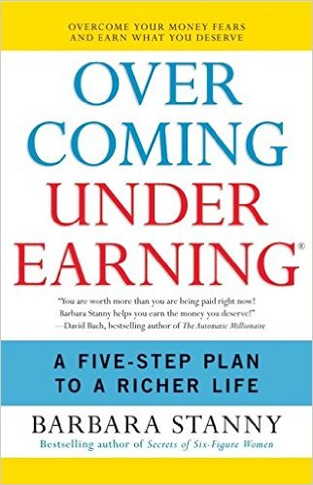
info@seejakeandjanetrain.com
Books:

Slide 53
info@seejakeandjanetrain.com
25% off
Any of our courses
www.seejakeandjanetrain.com
/sign-in-sign-up

Slide 54
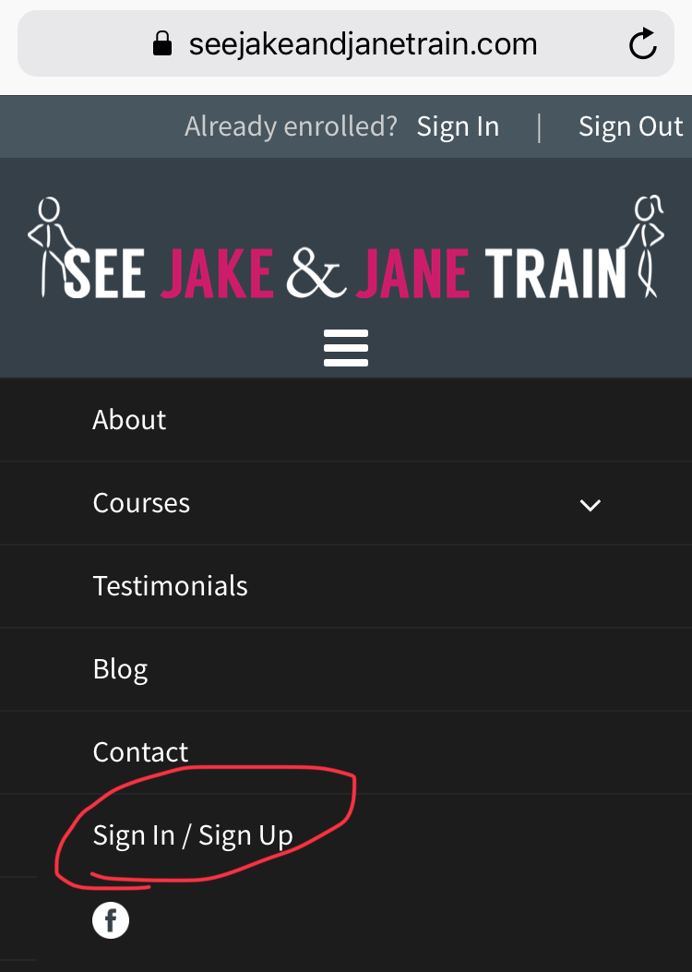
info@seejakeandjanetrain.com
25% off
Ends 4/2/18
At midnight
Code: NSCA
Notes:
www.seejakeandjanetrain.com
Sign-in/sign-up page

Slide 55
info@seejakeandjanetrain.com
Thank you!
Michelle Blakely
See Jake and Jane Train
www.seejakeandjanetrain.com
Notes:
Reach out anytime!

